Slide 1
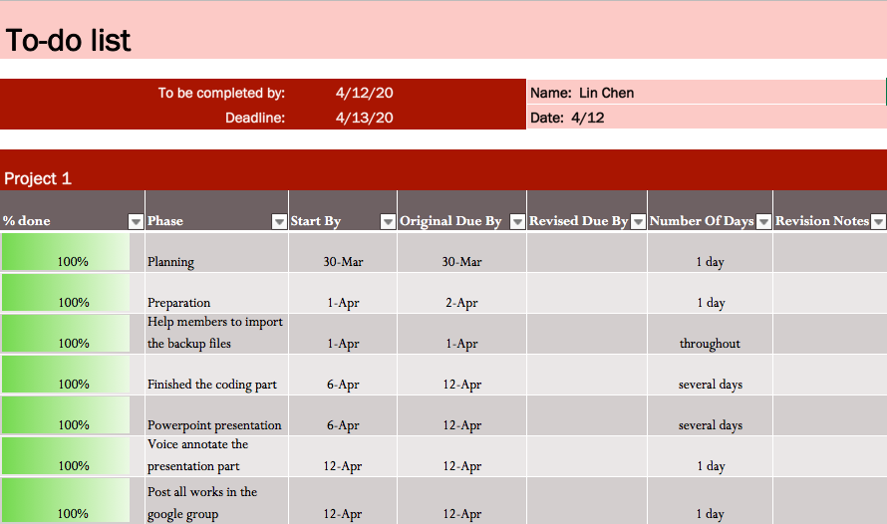
TO-DO LIST FOR LIN CHEN

Slide 2
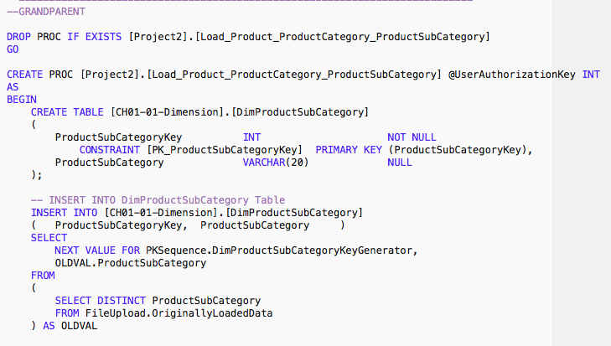
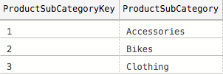
Create DimProductSubCategory table

Slide 3
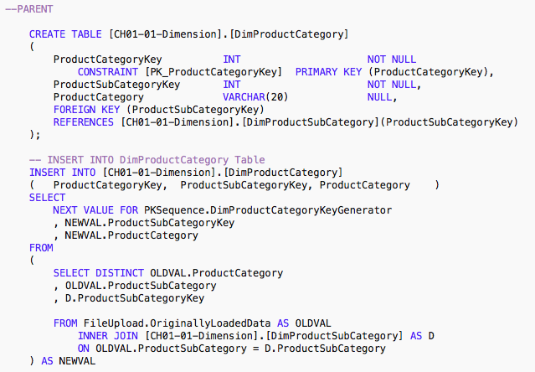
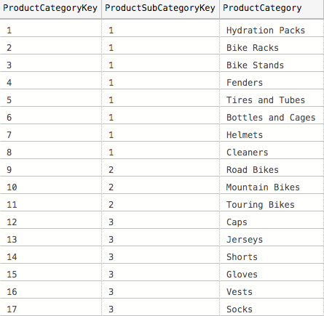
Create DimProductCategory table

Slide 4
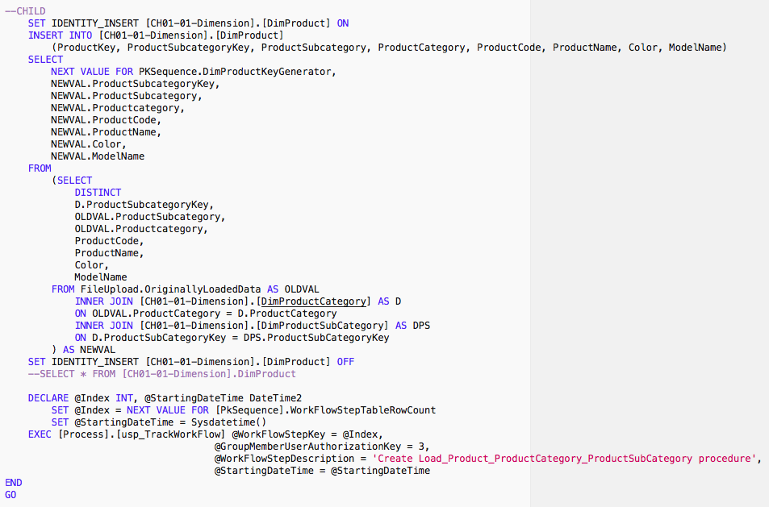

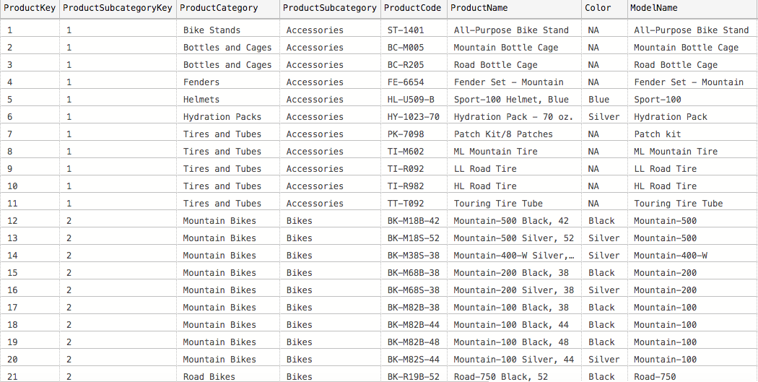
Load data into DimProduct table

Slide 5
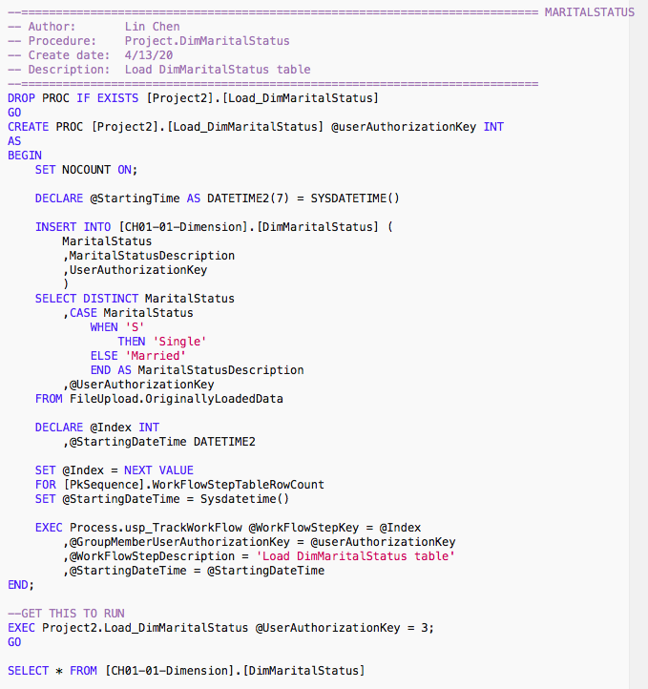
Create Load_DimMaritalStatus procedure which load data into DimMaritalStatus table

Slide 6
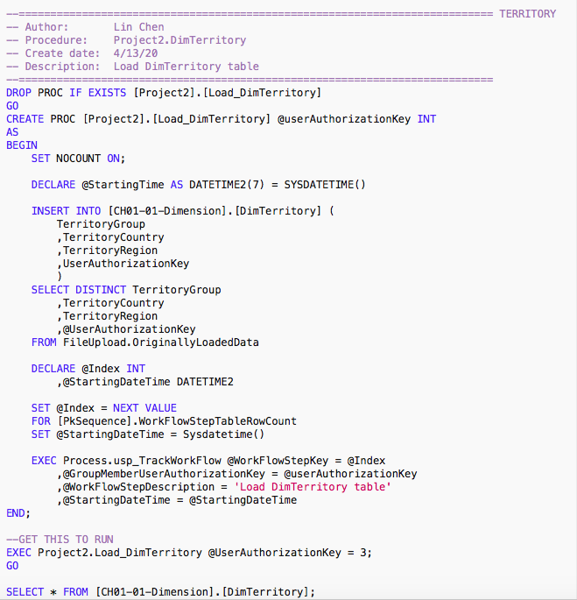

Create Load_DimTerritory procedure which load data into DimTerritory table

